Slide 1
Shoot The Object - HoloLens
- Kiran C Shettar

Slide 2
Overview
Project Description
Tools Used
Approach
Performance Testing
Challenges and Learnings

Slide 3
Project Description
Using HoloLens device, a user can play a shooting game
The features include:
Object gazing
Gesture control
Voice commands

Slide 4
Tools Used
Unity 2017.2.0f3 vs Blender and Maya
Create 3D models
Universal Windows Platform – D3D and VR support
HoloLens App settings – 60Hz
Background Color – Black (transparent)
Spatial Perception and Microphone
Visual Studio 2017 Preview
Create and edit C# scripts
Windows 10 SDK, Architecture x86

Slide 5
Tools Used (Continued..)
HoloLens Emulator 10.0.14393.1358
Runs on Hyper-V (Virtual Machine)
Device Portal support
Keyboard, mouse, controller
Load different rooms (5)
Windows 10 Home not supported
HoloLens Device

Slide 6
Approach
Gaze
Gesture
Spatial Mapping
Voice Commands
Spatial Audio

Slide 7
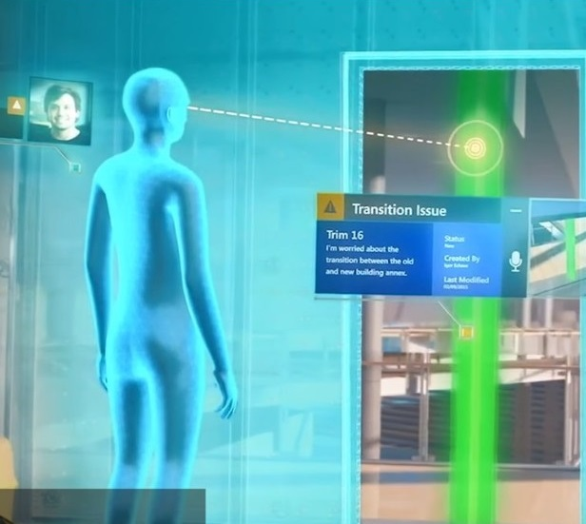
Gaze
Mouse Cursor Equivalent
Target and Select
Head Movement
Cursor & Hug Surface

Slide 8

Gaze (Continued..)
Classes Used
MeshRenderer
RaycastHit
Quaternion
Cursor Hugs Surface

Slide 9
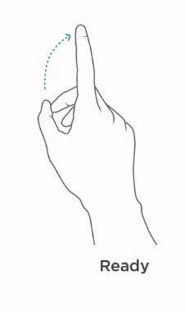
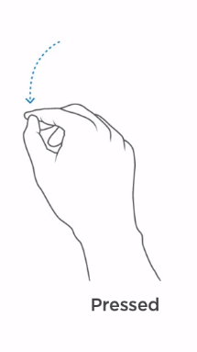
Gesture
Mouse button equivalent
Actions:
Ready State
Pressed State

Slide 10
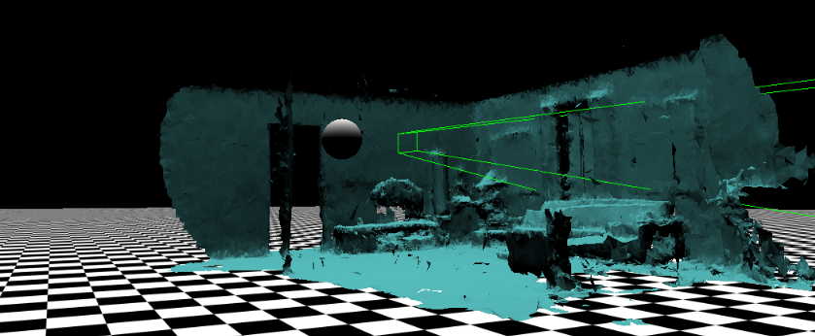
Spatial Mapping
API’s – Unity and Universal Windows Platform

Slide 11
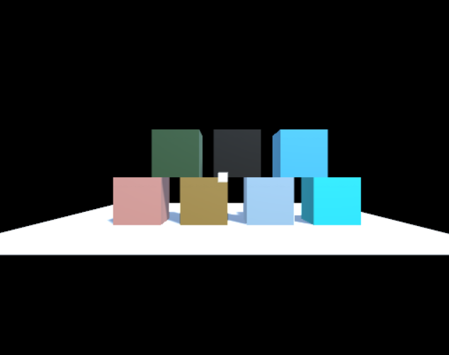
Voice Commands
Classes Used and Other
KeywordRecognizer
PhraseRecognizedEventArgs
Voice Commands:
Reset blocks
Shoot

Slide 12
Spatial Audio
Classes Used and Other
AudioSource
AudioClip
Spatial Audio:
Shoot Ball

Slide 13

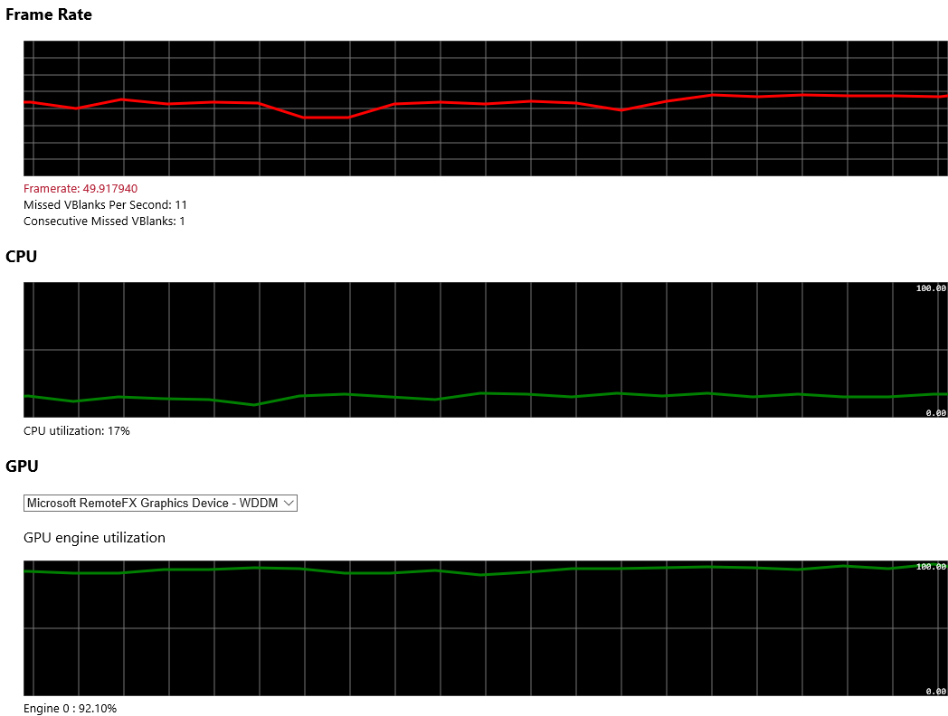



Performance Testing

Slide 14
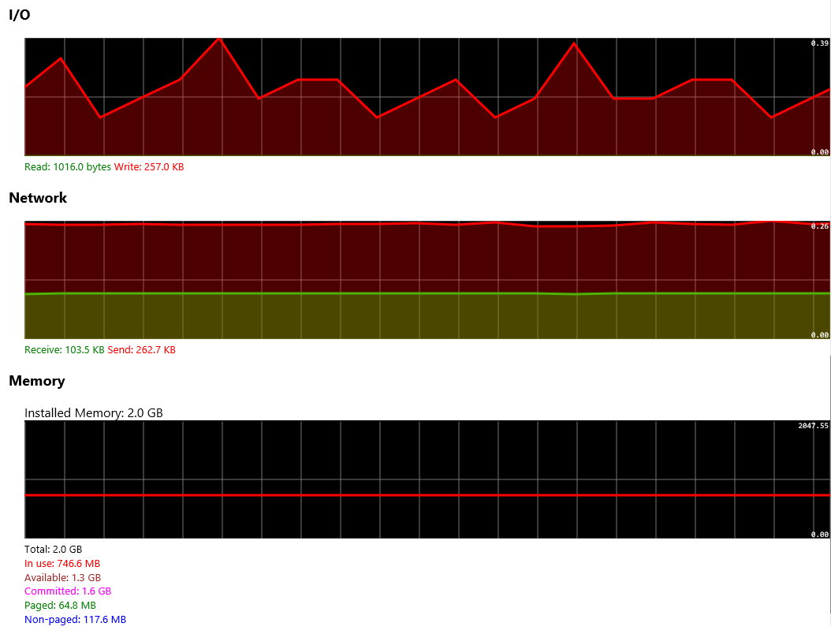
Performance Testing (Continued..)

Slide 15
Challenges and Learnings
Challenges Faced:
New to Unity & AR Development
Compiling Issues (Unity)
Implementing Voice Commands
Learnings:
Develop a mixed reality app using HoloLens Device
Understanding the windows device portal
Create Models in Unity

Slide 16
Demo
User Manual
Video Yet to be Added

Slide 17
Thank You

